Slide 1
Sharing Objects and Code
Notes:
Schedule: Timing Topic
50 minutes Lecture
30 minutes Practice
80 minutes Total

Slide 2
Objectives
After completing this lesson, you should be able to do the following:
  Describe the various methods for reusing objects and code
  Inherit properties from property classes
  Group related objects for reuse
  Explain the inheritance symbols in the Property Palette
  Reuse objects from an object library
  Reuse PL/SQL code
Notes:
Introduction
Overview
Forms Builder includes some features specifically for object and code reuse. In this lesson, you learn how to share objects between form modules using the Object Library. You also learn how to share code using the PL/SQL Library.

Slide 3
Benefits of Reusing Objects and Code
  Increases productivity
  Decreases maintenance
  Increases modularity
  Maintains standards
  Improves application performance
Notes:
Benefits of Reusable Objects and Code
When you are developing applications, you should share and reuse objects and code wherever possible in order to:
Increase productivity: You can develop applications much more effectively and efficiently if you are not trying to “start over” each time you write a piece of code. By sharing and reusing frequently used objects and code, you can cut down development time and increase productivity.
Decrease maintenance: By creating applications that use or call the same object or piece of code several times, you can decrease maintenance time.
Increase modularity: Sharing and reusing code increases the modularity of your applications.
Maintain standards: You can maintain standards by reusing objects and code. If you create an object once and copy it again and again, you do not run the risk of introducing minor changes. In fact, you can create a set of standard objects and some pieces of standard code and use them as a starting point for all of your new form modules.

Slide 4
Notes:
Benefits of Reusable Objects and Code (continued)
Improved application performance: When Forms Services communicates the user interface to the Forms Client, it sends meta-data about the items on the form. This meta-data includes values of properties that differ from the default. Once an item is defined, the meta-data about the next item includes only those properties that differ from the previous item. This is referred to as message diffing. Promoting similarities among items by using the methods of object reuse presented in this lesson improves the efficiency of message diffing and thus decreases network traffic and increases performance.
Promoting Similarities Among Objects
One of the easiest ways a developer can increase the efficiency of network performance through message diffing is by using consistent standards for all objects within an application. Items of different types should at least have common values for common or shared properties.
To maximize reuse, the developer should apply the following guidelines in the order shown:
Accept default properties as much as possible: If the properties are not overwritten for each object, then the value for common properties will be the same regardless of the the object type, except for position and size.
Use SmartClasses to describe an object: If, because of design standards, the use of default properties is not a viable option, then the subclassing of objects from a set of SmartClasses ensures that the development standards are being met. It also forces a high degree of property sharing across widgets. Items of the same type will then have (unless overridden) the same properties and hence will be able to share properties more effectively. You will earn about SmartClasses in this lesson.
Use sets of visual attributes: If SmartClasses are not being used to enforce standards and common properties then use sets of partial visual attributes to enforce a common set of properties across objects of different types: for example, font, font size, foreground color, background color, and so on. These sets of visual attributes can be defined as Property Classes, as explained in the following slides.

Slide 5
What Are Property Classes?
Canvas
properties
Relation
properties
Block
properties
Item
properties
LOV
properties
Notes:
Property Class
What is a property class?
A property class is a named object that contains a list of properties and their settings.
Why use property classes?
Use property classes to:
Increase productivity by setting standard or frequently used values for common properties and associating them with several Forms Builder objects. You can use property classes to define standard properties not just for one particular object, but for several at a time. This results in increased productivity, because it eliminates the time spent on setting identical properties for several objects.
Improve network performance by increasing the efficiency of message diffing.

Slide 6
Creating a Property Class
Add Property
Inherit Property
Delete Property
Property Class
Notes:
Creating a Property Class
When you create a property class, you have all the properties from every Forms Builder object available. You choose the properties and their values to include in the property class. You can create a property class in two ways:
Using the Create button in the Object Navigator
Using the Create Property Class button
How to create a property class from the Object Navigator
1. Click the Property Class node.
2. Click Create. A new property class entry displays.
3. Add the required properties and their values using the Add Property button in the Property Palette.
How to create a property class from the Property Palette
1. In the Object Navigator, click the object whose properties you want to copy into a property class.
2. Move to the Property Palette, select the properties you want to copy into a property class, and click the Property Class icon. An information alert is displayed.
3. Use the Object Navigator to locate the property class and change its name.

Slide 7
Notes:
Creating a Property Class (continued)
Adding a property
Once you create a property class, you can add a property by clicking the Add Property button and selecting a property from the list. Set the value for that property using the Property Palette.
You can also use the Copy Properties button and the Paste Properties button to add several properties at a time to a property class.
Deleting a Property
You can remove properties from a property class using the Delete Property button.
Instructor Note
Create a property class in the Property Palette.
Create a property class in the Object Navigator.
Include properties for different objects.
Associate a property class with an object.

Slide 8
Inheriting from a Property Class
Property palette
Property palette
Property
class
Default property
Default property
Default property
Default property
Default property
Change
Default property
Changed property
Apply
Property palette
Property palette
Inherited property
Change
Inherited property
Variant property
Inherited property
Inherited property
Inherit
Inherited property
Inherited property
Notes:
Inheriting from a Property Class
Once you create a property class and add properties, you can use the property class. To apply the properties from a property class to an object, use the Subclass Information property in the Property Palette.
What is an inherited property?
An inherited property is one that takes its value from the property class that you associated with the object. An inherited property is displayed with an arrow to the left of the property name.
What is a variant property?
A variant property is one that has a modified value even though it is inherited from the property class associated with the object. You can override the setting of any inherited property to make that property variant. Variant properties are displayed with a red cross over an arrow.

Slide 9
Inheriting from a Property Class
  Set the Subclass Information property.
  Convert an inherited property to a variant property.
  Convert a variant property to an inherited property.
  Convert a changed property to a default property.
Inherited Property
Variant Property
Default Property
Changed Property
Notes:
Inheriting from a Property Class (continued)
How to inherit property values from a property class
1. Click the object to which you want to apply the properties from the property class.
2. Click the Subclass Information property in the Property Palette.
3. Select the property class whose properties you want to use. The object takes on the values of that property class. Inherited properties are displayed with an arrow symbol.
Converting an inherited property to a variant property
To convert an inherited property to a variant property, simply enter a new value over the inherited one.
Converting a variant property to an inherited property
To convert a variant property to an inherited property, click the Inherit icon in the Property Palette.
Converting a changed property to a default property
You can also use the Inherit icon to revert a changed property back to its default.

Slide 10
What Are Object Groups?
Object groups:
  Are logical containers
  Enable you to:
    Group related objects
    Copy multiple objects in one operation
Notes:
What Are Object Groups?
An object group is a logical container for a set of Forms Builder objects.
Why use object groups?
You define an object group when you want to:
Package related objects for copying or subclassing in another module
Bundle numerous objects into higher-level building blocks that you can use again in another application.
Example
Your application can include an appointment scheduler that you want to make available to other applications. You can package the various objects in an object group and copy the entire bundle in one operation.

Slide 11
Creating and Using Object Groups
  Blocks include:
    Items
    Item-level triggers
    Block-level triggers
    Relations
  Object groups cannot include other object groups
  Deleting an object group does not affect the objects
  Deleting an object affects the object group
Notes:
Creating and Using Object Groups
How to create an object group
1. Click the Object Group node in the Object Navigator.
2. Click the Create icon. A new object group entry is displayed.
3. Rename the new object group.
4. Click the form module and expand all.
5. Control-click all the objects of one type that you want to include in the object group.
6. Drag the selected objects into the new object group entry. The objects are displayed as object group children.
7. Repeat steps 5 and 6 for different object types.
The objects in the object group are still displayed in their usual position in the Object Navigator, as well as within the object group. The objects in the object group are not duplicates, but pointers to the source objects.

Slide 12
Notes:
Creating and Using Object Groups (continued)
Things to consider when using object groups
Including a block in an object group also includes its items, the item-level triggers, the block-level triggers and the relations. You cannot use any of these objects in an object group without the block.
It is not possible to include another object group.
Deleting an object from a module automatically deletes the object from the object group.
Deleting an object group from a module does not delete the objects it contains from the module.
Subclass Information dialog box
The Subclass Information property of a form object shows a dialog box that provides information about the origins of the object. You can see whether an object is local to the form document or foreign to it. If the object is foreign to the current form, the Module field shows the module from which the object originates. The original object name is shown in the Object Name field.
Instructor Note
Create an object group.
Include a block, canvas-view, and form-level trigger.
Point out that the objects in the object group are still visible in their respective positions in the Object Navigator.
Drag the object group and drop it into a second form module.

Slide 13
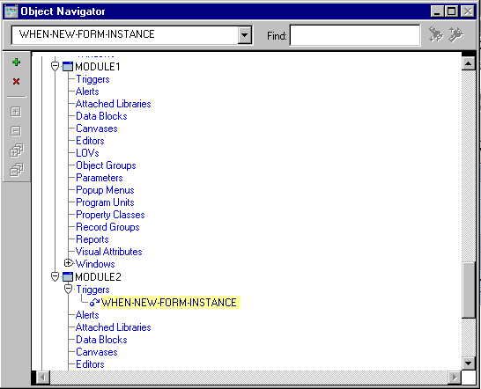
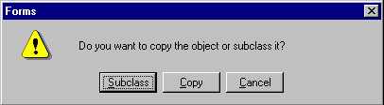
Copying and Subclassing Objects and Code
Notes:
Copying and Subclassing Objects and Code
You can copy or subclass objects:
Between modules, by dragging objects between the modules in the Object Navigator
Within a single module by selecting the object in the Object Navigator, pressing [Ctrl], and dragging it to create the new object
When you drag objects, a dialog box appears that asks whether you want to copy or subclass the object.
Copying an object
Copying an object creates a separate, unique version of that object in the target module. Any objects owned by the copied object are also copied.
Points to remember
Use copying to export the definition of an object to another module.
Changes made to a copied object in the source module do not affect the copied object in the target module.

Slide 14
Subclassing
Company Name:
Company Code:
Balance:
Ability
to alter
properties
of child
object
Ability
to add to
child object
Ability
to inherit
changes
Company Name:
Company Name:
Company Name:
Company Code:
Company Code:
Company Code:
Balance:
Balance:
Balance:
Address:
Code:
Notes:
Subclassing an Object
With subclassing you can make an exact copy, and then alter the properties of some objects if desired. If you change the parent class, the changes also apply to the properties of the subclassed object that you have not altered. However, any properties that you override remain overridden. This provides a powerful object inheritance model.
When you subclass a data block, you can:
Change the structure of the parent, automatically propagating the changes to the child
Add or change properties to the child to override the inheritance
When you subclass a data block you cannot:
Delete items from the child
Change the order of items in the child
Add items to the child unless you add them to the end
Note: Subclassing is an object-oriented term that refers to the following capabilities:
Inheriting the characteristics of a base class (Inheritance)
Overriding properties of the base class (Specialization)

Slide 15
Notes:
Subclassing an Object (continued)
Ability to add to an object
You can create an exact copy of an object, and you can add to the subclassed object. For example, you can add additional items to the end of a subclassed block.
Ability to alter properties
With subclassing, you can make an exact copy and then alter the properties of some objects. If you change the parent class, the changes also apply to the properties of the subclassed object that you have not altered. However, any properties that you override remain overridden.
Ability to inherit changes
When you change the properties of a parent object, all child objects inherit those properties if they are not already overridden.
The child inherits changes:
Immediately, if the parent and child objects are in the same form
When you reload the form containing a child object
Ability to re-inherit
If you make changes to the child object to override properties of the parent object, you can click the Inherit icon to re-inherit the property from the parent object.
Property Palette icons: Enable you to identify inherited or overridden properties.
Instructor Note
Demonstration: Open the following forms: referenced.fmb, copied.fmb, and subclassed.fmb. The referenced.fmb module contains a block with a single item. Open the Property Palette for that item and show that the X Position, Y Position, Width, and Height properties are all set to 20. As you make changes in properties in this demo, point out the different icons for inherited and overridden properties.
Drag and drop the block into copied.fmb and subclassed.fmb, copying it in the first case and subclassing it in the second. Change the item’s Width in referenced.fmb. Demonstrate that the change is propagated to subclassed.fmb, but not to copied.fmb.
In subclassed.fmb, change the Height property of the item to 40. Now change the Height property of the item in referenced.fmb to 10. Return to subclassed.fmb and show that the overridden Height of 40 is still in effect. Select the Height property and click the Inherit icon. Point out to students that the new Height of 10 is inherited from referenced.fmb, not the original height of 20.

Slide 16
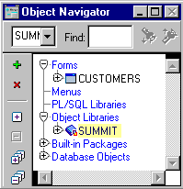
What Are Object Libraries?
An Object Library:
  Is a convenient container of objects for reuse
  Simplifies reuse in complex environments
  Supports corporate, project,
  and personal standards
  Simplifies the sharing of
  reusable components
  Is separate from the
  form module
Notes:
What Are Object Libraries?
Object libraries are convenient containers of objects for reuse. They simplify reuse in complex environments, and they support corporate, project, and personal standards.
An object library can contain simple objects, property classes, object groups, and program units, but they are protected against change in the library. Objects can be used as standards (classes) for other objects.
Object libraries simplify the sharing of reusable components. Reusing components enables you to:
Apply standards to simple objects, such as buttons and items, for consistent look and feel. This also improves network performance by promoting similarities among objects, thus increasing the efficiency of message diffing.
Reuse complex objects such as a Navigator.
In combination with SmartClasses, which are discussed later, object libraries support both of these requirements.

Slide 17
Notes:
What Are Object Libraries? (continued)
Why object libraries instead of object groups?
Object libraries are external to the form, so are easily shared among form modules.
Object libraries can contain individual items; for example, iconic buttons. The smallest unit accepted in an object group is a block.
Object libraries accept PL/SQL program units.
If you change an object in an object library, all forms that contain the subclassed object reflect the change.
Instructor Note
An object library is part of an application; you distribute it with the completed application.

Slide 18

Benefits of the Object Library
  Simplifies the sharing and reuse of objects
  Provides control and enforcement of standards
  Promotes increased network performance
  Eliminates the need to maintain multiple referenced forms
Notes:
Benefits of the Object Library
There are several advantages to using object libraries to develop applications:
Simplifies the sharing and reuse of objects
Provides control and enforcement of standards
Increases the efficiency of message diffing by promoting similarity of objects, thus increasing the performance of the application
Eliminates the need to maintain multiple referenced forms

Slide 19
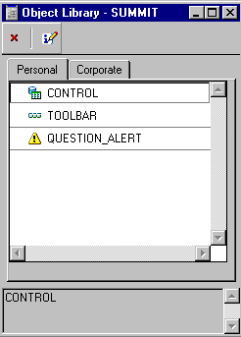
Working with Object Libraries
Object Libraries:
  Appear in the Navigator if they are open
  Are used with a simple tabbed interface
  Are populated by dragging Form objects to tab page
  Are saved to .olb file
Notes:
Working with Object Libraries
Object libraries appear in the Navigator if they are open. You can create, open, and close object libraries like other modules. Forms Builder automatically opens all object libraries that were open when you last closed Forms Builder.
It is easy to use object libraries with a simple tabbed interface. Using the Edit menu, you can add or remove tab pages that help you to create your own groups. You can save object libraries to a file system as .olb files.
Note: You cannot modify objects inside the object library itself. To make changes, drag the object into a form, change it, and drag it back to the object library.
How to populate an Object Library
1. Select Tools > Object Library to display the object library.
2. Drag objects from the Object Navigator into the object library.
3. You can edit the descriptive comment by clicking the Edit icon in the object library interface.

Slide 20
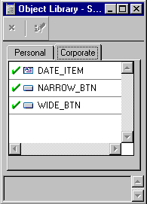
What Is a SmartClass?
  A SmartClass:
    Is an object in an object library that is frequently used as a class
    Can be applied easily and rapidly to existing objects
    Can be defined in many object libraries
    Is the preferred method to
    promote similarity among
    objects for performance
  You can have many SmartClasses of a given object type.
Check indicates
a SmartClass
Notes:
What Are SmartClasses?
A SmartClass is a special member of an Object Library. It can be used to easily subclass existing objects in a form using the SmartClass option from the right mouse button popup menu. To use Object Library members which are not SmartClasses, you have to use the Subclass Information dialog available in the Property Palette of the form object that you are modifying.
If you frequently use certain objects as standards, such as standard buttons, date items, and alerts, you can mark them as SmartClasses by selecting each object in the object library and choosing Edit > SmartClass.
You can mark many different objects, spread across multiple object libraries, as SmartClasses. Other than accepting default values for all object properties, using Smart Classes is the preferred method to promote similarities between objects for efficiency of message diffing, resulting in better performance of applications.
You can also have many SmartClasses of a given object type, for example:
Wide_button
Narrow_button
Small_iconic_button

Slide 21
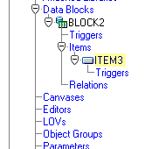
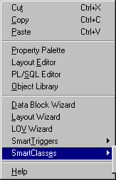

Working with SmartClasses
  1. Right-click an object in the Layout Editor or Navigator.
  2. From the pop-up menu,
  select SmartClasses.
  3. Select a class from
  the list.
Notes:
Working with SmartClasses
To apply a SmartClass to a Forms object, perform the following steps:
1. Right-click an object in the Layout Editor or Navigator.
2. From the pop-up menu, select SmartClasses. The SmartClasses pop-up menu lists all the SmartClasses from all open object libraries that have the same type as the object, and, for items, also have the same item type; for example, push button, text item..
3. Select a class for the object; it then becomes the parent class of the object. You can see its details in the Subclass Information dialog box in the object’s Property Palette, just like any other subclassed object.
This mechanism makes it very easy to apply classes to existing objects.

Slide 22
Reusing PL/SQL
  Triggers:
    Copy and paste text
    Copy and paste within a module
    Copy to or subclass from another module
    Move to an object library
  PL/SQL program units:
    Copy and paste text
    Copy and paste within a module
    Copy to or subclass in another module
    Create a library module
    Move to an object library
Notes:
Reusing PL/SQL
PL/SQL in Triggers
You can reuse the PL/SQL in your triggers by:
Copying and pasting, using the Edit menu
Copying to another area of the current form module, using Copy and Paste on the menu of the right mouse button
Copying to or subclassing from another form module, using drag and drop in the Object Navigator
Moving the trigger to an object library
PL/SQL program units
Although triggers are the primary way to add programmatic control to a Forms Builder application, using PL/SQL program units supplement triggers, you can reuse code without having to retype it.
With Forms Builder, you can create PL/SQL program units to hold commonly used code. These PL/SQL program units can use parameters, which decrease the need to hard-code object names within the procedure body.

Slide 23
Notes:
Reusing PL/SQL (continued)
You can reuse PL/SQL program units by:
Copying and pasting, using the Edit menu
Copying or subclassing to another form module, using drag and drop in the Object Navigator
Creating a library module
Moving the program unit to an object library

Slide 24

What Are PL/SQL Libraries?
Applications
Procedures
Functions
Form modules
Menu modules
Report modules
.pll file
Packages
Library
Notes:
What Are PL/SQL Libraries?
A library is a collection of PL/SQL program units, including procedures, functions, and packages. A single library can contain many program units that can be shared among the Oracle Forms Developer modules and applications that need to use them.
A library:
Is produced as a separate module and stored in either a file or the database
Provides a convenient means of storing client-side code and sharing it among applications
Means that a single copy of program units can be used by many form, menu, or report modules
Supports dynamic loading of program units
Scoping of objects
Because libraries are compiled independently of the Forms modules that use them, bind variables in forms, menus, reports, and displays are outside the scope of the library. This means that you cannot directly refer to variables that are local to another module, because the compiler does not know about them when you compile the library program units.

Slide 25
Writing Code for Libraries
  A library is a separate module, holding procedures, functions, and packages.
  Direct references to bind variables are not allowed.
  Use subprogram parameters for passing bind variables.
  Use functions, where appropriate,
  to return values.
Notes:
Writing Code for PL/SQL Libraries
There are two ways to avoid direct references to bind variables:
You can refer to global variables and system variables in forms indirectly as quoted strings by using certain built-in subprograms.
Write program units with IN and IN OUT parameters that are designed to accept references to bind variables. You can then pass the names of bind variables as parameters when calling the library program units from your Forms applications.
Example
Consider the second method listed above in the following library subprogram:
FUNCTION locate_emp(bind_value IN NUMBER) RETURN VARCHAR2 IS
v_ename VARCHAR2(15);
BEGIN
SELECT last_name INTO v_ename FROM employees
WHERE employee_id = bind_value;
RETURN(v_ename);
END;

Slide 26
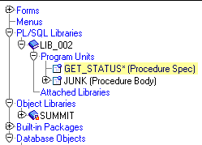
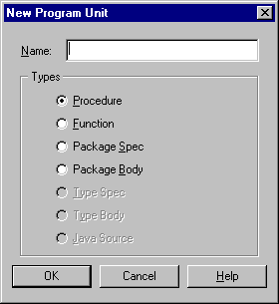
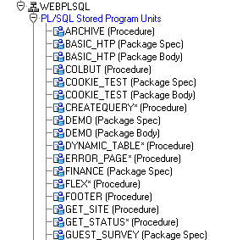
Creating Library Program Units
TEST
Notes:
Working with PL/SQL Libraries
Creating a library
You must first create libraries in the builder before you add program units. To do this, you can either:
Select File > New > PL/SQL Library from the menus (An entry for the new library then appears in the Navigator.)
Select the Libraries node in the Object Navigator, and select the Create tool from the tool bar
There is a Program Units node within the library’s hierarchy in the Navigator. From this node, you can create procedures, functions, package bodies, and specifications in the same way as in other modules.
How to save the library
1. With the context set on the library, select the Save option in Forms Builder.
2. Enter the name by which the library is to be saved.

Slide 27
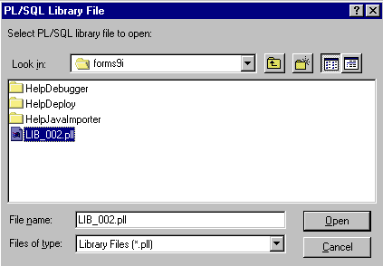
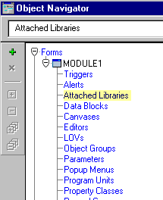
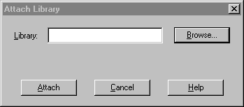
Attach Library Dialog Box
Notes:
Working with PL/SQL Libraries (continued)
How to attach a library
Before you can refer to a library program unit from a form, menu, report, or graphics, you must attach the library to the modules.
To attach a library to a module:
1. Open the module that needs to be attached to the library. This may be a form, menu, or another library module.
2. Expand the module and select the Attached Libraries node in the Navigator. When you select Create, the Attach Library dialog box appears.
3. In the Attach Library dialog box, specify the library’s name.
4. Click Attach.
5. Save the module to which you have attached the library. This permanently records the library attachment in the definition of this module.
Detaching a library
To later detach a library, simply delete the library entry from the list of Attached Libraries for that module, in the Navigator. That module will then no longer be able to reference the library program units, either in the Builder or at run time.

Slide 28
Calls and Searches
Calls
procedure ( );
...function...
package.call ( );
Searches
Program Units
PROCA
PROCB
Attached Libraries
Database
Notes:
Referencing Attached Library Program Units
You refer to library program units in the same way as those that are defined locally, or stored in the database. Remember that objects declared in a package must be referenced with the package name as a prefix, whether or not they are part of a library.
Program units are searched for first in the calling module, then in the libraries that are attached to the calling module.
Example
Assume that the program units report_totals, how_many_people, and pack5.del_emps are defined in an attached library:
report_totals(:sub1); --library procedure
v_sum := how_many_people; --library function
pack5.del_emps; --library package procedure

Slide 29
Notes:
Referencing Attached Library Program Units (continued)
When several libraries are attached
You can attach several libraries to the same Oracle Forms Developer module. References are resolved by searching through libraries in the order in which they occur in the attachment list.
If two program units of the same name and type occur in different libraries in the attachment list, the one in the “higher” library will be executed, since it is located first.
Creating .PLX Files
The library .PLX file is a platform-specific executable that contains no source.
When you are ready to deploy your application, you will probably want to generate a version of your library that contains only the compiled p-code, without any source. You can generate a .PLX file from Forms Builder or from the command line.
Example
The following command creates a run-time library named runlib1.plx based on the open library mylib.pll:
GENERATE LIB mylib FILE runlib1;

Slide 30
Summary
In this lesson, you should have learned that:
  You can reuse objects or code in the following ways:
    Property Classes
    Object Groups
    Copying and subclassing
    Object Libraries and SmartClasses
  To inherit properties from a property class, set an item’s Subclass Information property.
  You can create an object group in one module to make it easy to reuse related objects in other modules.
Notes:
Summary
Forms provides a variety of methods for reusing objects and code. This lesson described how to use these methods.
Reasons to share objects and code:
Increased productivity
Increased modularity
Decreased maintenance
Maintaining standards
Increased performance
Methods of sharing objects and code:
Property classes
Object groups
Copying
Subclassing
Creating a library module
Using object libraries and SmartClasses

Slide 31
Summary
  Inheritance symbols in the Property Palette show whether the value is changed, inherited, overridden, or the default.
  You can drag objects from an object library or mark them as SmartClasses for even easier reuse.
  You can reuse PL/SQL code by:
    Copying and pasting in the PL/SQL Editor
    Copying or subclassing
    Defining program units to call the same code at multiple places within a module
    Creating PL/SQL library to call the same code from multiple forms

Slide 32
Practice 22 Overview
This practice covers the following topics:
  Creating an object group and using this object group in a new form module
  Using property classes
  Creating an object library and using this object library in a new form module
  Modifying an object in the Object Library and observing the affect on subclassed objects
  Setting and using SmartClasses
Notes:
Practice 22 Overview
In this practice, you use an object group and an object library to copy Forms Builder objects from one form to another. You will also create a property class and use it to set multiple properties for several objects. You set SmartClasses in the object library and use these classes in the form module.
Creating an object group and using this object group in a new form module
Using property classes
Creating an object library and using this object library in a new form module
Modifying an object in the object library to see how the modification affects subclassed objects
Setting and using SmartClasses
Note
For solutions to this practice, see Practice 22 in Appendix A, “Practice Solutions.”

Slide 33
Notes:
Practice 22
1. In the ORDGXX form, create an object group, called Stock_Objects, consisting of the INVENTORIES block, CV_INVENTORY canvas, and WIN_INVENTORY window.
2. Save the form.
3. Create a new form module and copy the Stock_Objects object group into it.
4. In the new form module, create a property class called ClassA. Include the following properties and settings:
Font Name: Arial
Format Mask: 99,999
Font Size: 8
Justification: Right
Delete Allowed: No
Background Color: DarkRed
Foreground Color: Gray
5. Apply ClassA to CV_INVENTORY and the Quantity_on_Hand item.
6. Save the form module as STOCKXX.fmb, compile, and run the form and note the error.
7. Correct the error. Save, compile, and run the form again.
8. Create an object library and name it summit_olb.
Create two tabs in the object library called Personal and Corporate.
Add the CONTROL block, the Toolbar, and the Question_Alert to the personal tab of the object library.
Save the object library as summit.olb.
9. Create a new form, and create a data block based on the DEPARTMENTS table, including all columns except DN. Use the Form layout style.
Drag the Toolbar canvas, CONTROL block, and Question_Alert from the object library into the new form, and select to subclass the objects.. For proper behavior, the DEPARTMENTS block must be before the CONTROL block in the Object Navigator
Some items are not applicable to this form.
Set the Canvas property for the following items to NULL: Image_Button, Stock_Button, Show_Help_Button, Product_Lov_Button, Hide_Help_Button, Product_Image, Total.
The code of some of the triggers does not apply to this form. Set the code for the When-Button-Pressed triggers for the above buttons to: NULL;
For the Total item, set the Calculation Mode and Summary Function properties to None, and set the Summarized Block property to Null.
Use Toolbar as the Horizontal Toolbar canvas for this form.
Set the Window property to WINDOW1 for the Toolbar canvas.
Set the Horizontal Toolbar Canvas property to TOOLBAR for the window.

Slide 34
Notes:
Practice 22 (continued)
10. Save this form as DEPTGXX, compile, and run the form to test it.
11. Try to delete items on the Null canvas. What happens and why?
12. Change the Exit button of the Object Library’s CONTROL block to have a gray background. Run the Departments form again to see that the Exit button is now gray.

